Slide 1
Rising apartment prices in Gush Dan
Oded Saban
Chen Yank
Git Hub

Slide 2
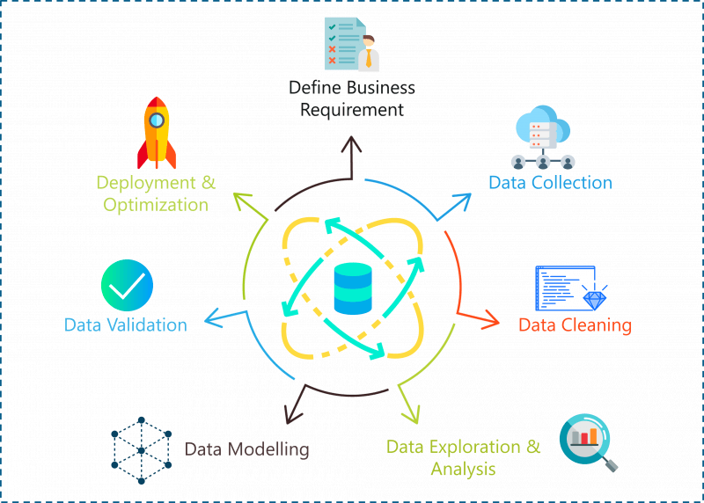

Research questions
Has there indeed been an increase in apartment prices as noticeable
Given the current price of an apartment, is it possible to predict its price in about 10 years

Slide 3
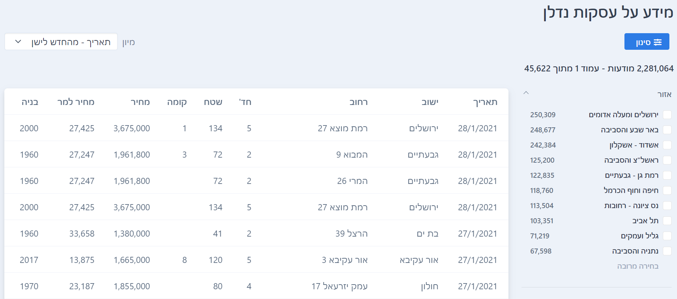
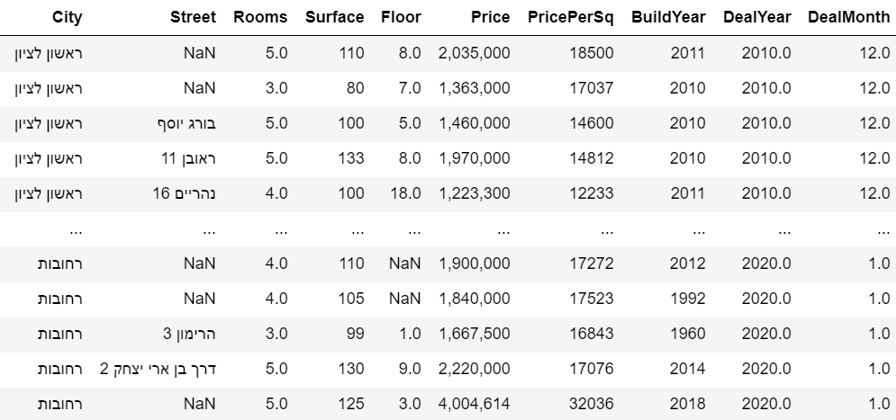
Data sources
Crawling - ad - Information on real estate transactions
First, we used the ‘BeautifulSoup’ library to crawl the relevant data from ad site.
Second, we add 2 columns, the first is DealYear, and the second is DealMonth.
Finally, we saved the data in the allDf.csv file

Slide 4

Data cleaning
NaN handling
Convert variables to uniform formats
Outliners handling

Slide 5
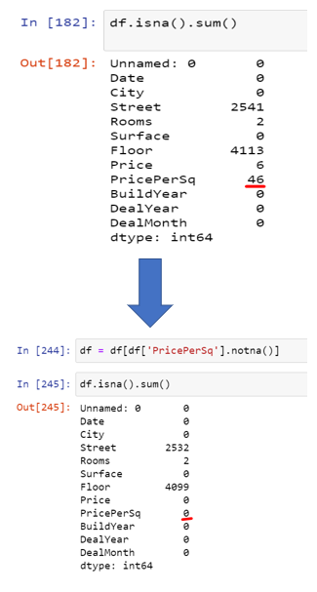
Data cleaning – NaN handling
We removed the data that appears as NaN in the PricePerSq column, because with this column we will analyze the data and it will not be possible if we have NaN values there.

Slide 6
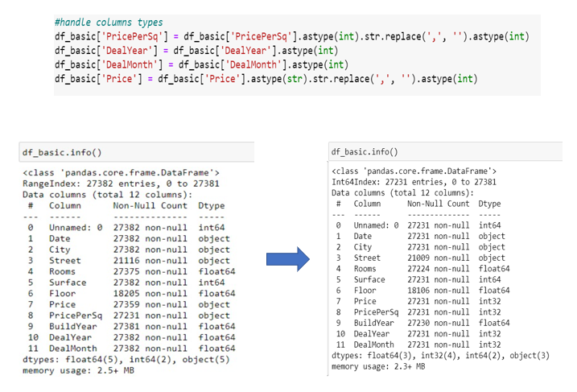
Data cleaning – Convert variables to uniform formats
We converted the values of the columns: Price, PricePerSq, DealYear, DealMonth from float64 and Object to int32. This is so that we can handle the data optimally when all the variables are of the same type.
It can be seen that during the conversion process of the Price and PricePerSq columns we deleted the character - , because an int32 variable could not contain the character - , .

Slide 7
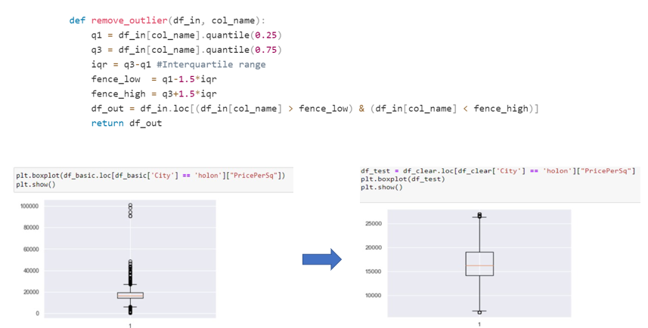
Data cleaning – Outliners
We handled outliners with percentages and during the process we used the boxplot graph belonging to the matplotlib library to analyze the efficiency of the handled.

Slide 8
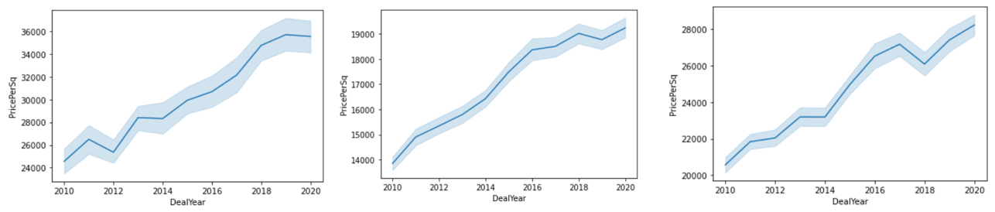
Exploring & visualizing the Data (EDA)
01
LinePlot
What the graph contain: The graph contain 2 axes : 1. X-axis is the DealYear 2. Y-axis is the PricePerSq Conclusion: With the help of the graph, we see that over the years there has been an increase in apartment prices in the various cities in Gush Dan.
Tel-Aviv Rishon-LeZion Givatayim

Slide 9
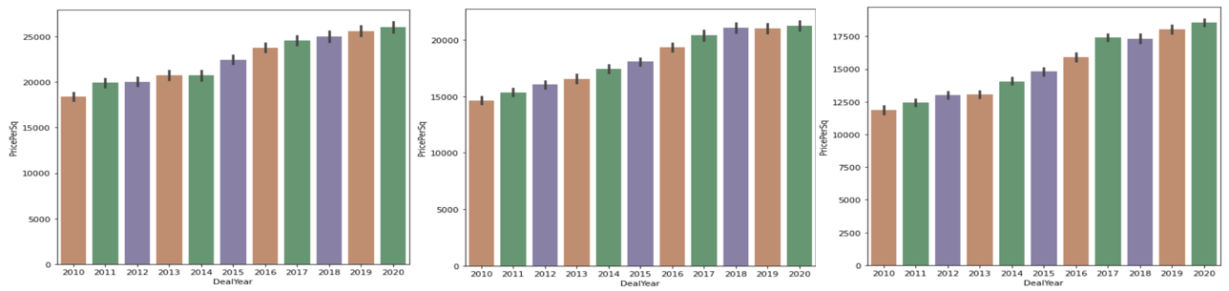
Exploring & visualizing the Data (EDA)
01
BarPlot
What the graph contain: The graph contain 2 axes : 1. X-axis is the DealYear 2. Y-axis is the PricePerSq Conclusion: With the help of the graph, we see that over the years there has been an increase in apartment prices in the various cities in Gush Dan.
Ramat-Gan Holon Rehovot

Slide 10
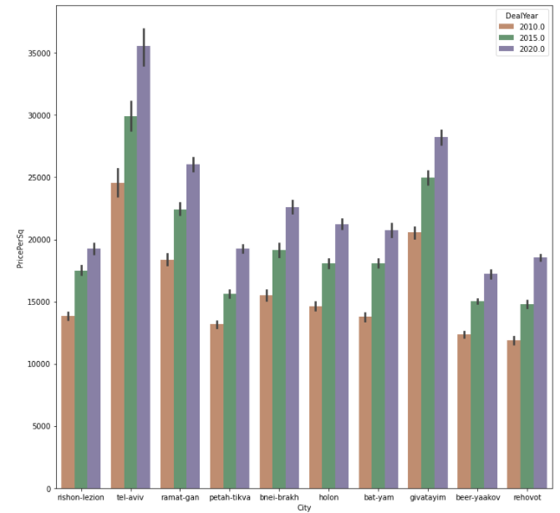
Exploring & visualizing the Data (EDA)
01

Slide 11
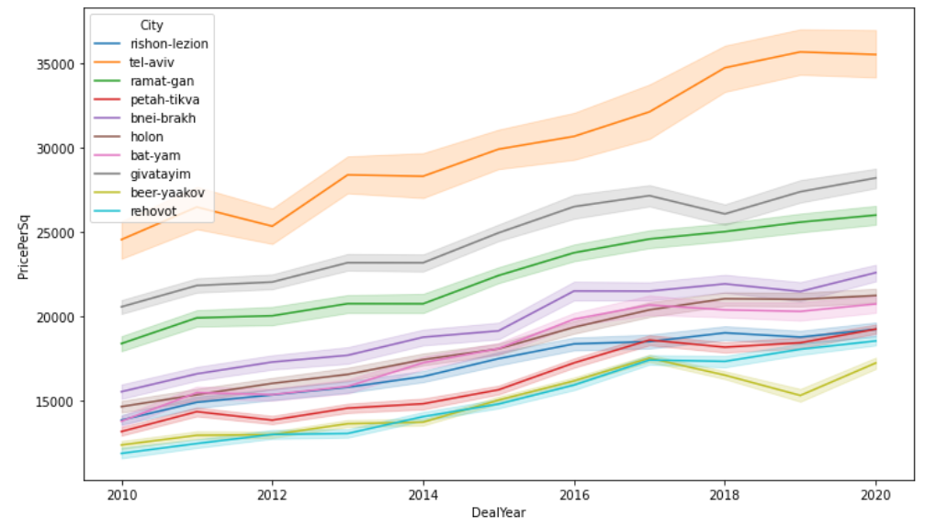
Exploring & visualizing the Data (EDA)
01

Slide 12

Machine Learning

Slide 13
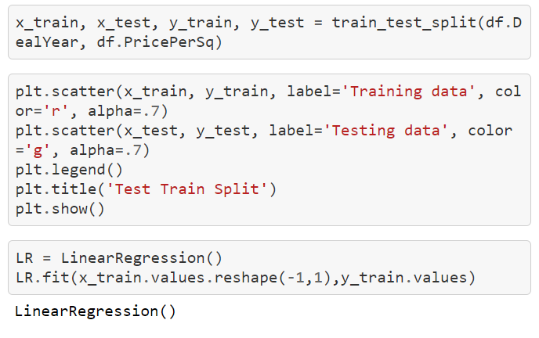
Machine Learning – linear regression
We used ‘sklearn’ library and linear regression.
With their help we trained a model that can predict the average price per square meter in the city and in the year we chose.

Slide 14
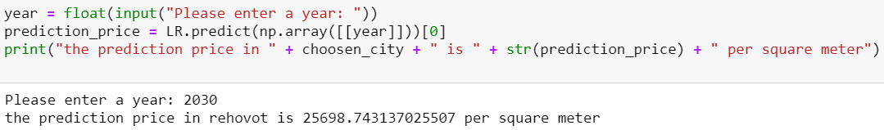
Machine Learning – linear regression
The program asks the user to enter the year for prediction and prints the model predicted price for that year.

Slide 15

Conclusions
In conclusion, according to the findings of the project, we understand that there has indeed been an increase in the prices of apartments in Gush Dan, and moreover, with the help of machine learning, we conclude that in the coming years prices will continue to rise.

